Slide 1
CAPSTONE REVIEW-III
Dachepalli sasank 21BCE9133
Ryali Purna Sri Sai Sumanth 21BCE9227
Chennupati Venkata Lakshman 21BCE9055
Chennupati Venkata Ram 21BCE9790

Slide 2
OUTLINE:
Abstract
Introduction
Problem statement
Objectives
Motivation
Contribution
Literature Review
Methodology
Result and discussion
Approach to Achieving Objectives
Conclusion
References

Slide 3
ABSTRACT:
This study presents a comprehensive comparison of seven deep learning models—GoogleNet, EfficientNet, ResNet, DenseNet, MobileNet, AlexNet, and Xception in detecting diseases in tomato and apple leaves. By leveraging convolutional neural network (CNN) architectures, we aim to automate plant disease identification, an essential step for improving crop health management. Our experiments show that GoogleNet deliver the highest accuracy, reaching up to 95.84%, respectively. This model demonstrate the potential to replace traditional manual inspection methods, which are often time-consuming and labor-intensive. Through our analysis, we propose that high-accuracy, automated disease detection using CNNs can aid farmers and agronomists in diagnosing diseases more efficiently, potentially increasing crop yield and quality while reducing the reliance on expert knowledge.

Slide 4
INTRODUCTION:
Maintaining crop health and minimizing production losses are critical challenges in agriculture, especially for high-value crops like apples and tomatoes, which hold significant nutritional and economic importance. Diseases such as apple scab, black rot, and cedar apple rust in apples, and bacterial spots, early blight, and late blight in tomatoes, pose serious threats to crop quality and yield. Timely and accurate identification of these diseases is essential to control their spread and improve overall agricultural productivity.
Recent advancements in computer vision and image processing have enabled automated disease detection using leaf imagery. Among these, deep learning techniques, particularly Convolutional Neural Networks (CNNs), have demonstrated superior accuracy and generalization compared to traditional methods. These models analyze the visual attributes of leaves to classify diseases effectively. In this study, we present an optimized GoogleNet model designed specifically for classifying diseases affecting apple and tomato foliage. This approach leverages the efficiency and accuracy of CNNs to provide a reliable and scalable solution for addressing critical challenges in modern agriculture.

Slide 5
PROBLEM STATEMENT:
Diseases affecting the leaves of apple and tomato plants significantly reduce crop yield and quality, posing a major challenge to agricultural productivity. Traditional methods for identifying plant diseases are labor-intensive, time-consuming, and require expert knowledge, making them unsuitable for large-scale agricultural operations. Furthermore, delayed or inaccurate diagnosis exacerbates the spread of infections, leading to increased use of pesticides, higher production costs, and environmental concerns. Despite advancements in digital tools for plant disease detection, many existing models either lack the precision required for accurate classification or are computationally expensive, making them impractical for real-time applications in resource-limited settings. This highlights the need for a scalable, efficient, and accurate system capable of diagnosing multiple plant diseases using minimal resources. Addressing these challenges, the project aims to develop a robust and efficient deep learning-based framework for classifying diseases in apple and tomato leaves, enabling timely intervention and reducing the economic impact on farmers.

Slide 6
OBJECTIVEs:
Disease Identification:
Develop a robust deep learning-based system to accurately identify and classify diseases in Apple and Tomato leaves across 14 distinct categories.
Model Evaluation:
Evaluate the performance of various state-of-the-art deep learning models, Like EfficientNet, GoogleNet..etc, to determine the most effective architecture for this task.
Optimal Model Selection:
Identify the model that achieves the highest accuracy, precision, recall, and F1 score for leaf disease classification, ensuring its suitability for practical deployment.
Real-Time Feasibility:
Design and implement a computationally efficient model with low latency and minimal resource requirements to support real-time disease detection in agricultural settings.

Slide 7
Generalization Capability:
Incorporate data augmentation and regularization techniques to improve the model's ability to generalize across diverse and unseen data samples.
Performance Analysis:
Conduct a detailed analysis of training and validation metrics, including accuracy, loss, and overfitting patterns, to ensure the stability and reliability of the final model.
Agricultural Application:
Provide a scalable and user-friendly solution that aids farmers and agricultural professionals in early disease detection and prevention, thereby enhancing crop yield and reducing losses.

Slide 8
MOTIVATION:
Agriculture is a cornerstone of global food security and economic stability, with crops like apples and tomatoes being highly valued for their nutritional and economic significance. Despite their importance, these crops are vulnerable to a range of diseases such as apple scab, black rot, cedar apple rust, bacterial spots, early blight, and late blight. These diseases severely impact crop yield and quality, posing challenges to farmers and the agricultural supply chain. Traditional disease detection methods, which rely on manual inspection, are labor-intensive, time-consuming, and prone to inaccuracies. The lack of scalable, automated, and precise solutions in this domain motivated this project to develop a deep learning-based framework capable of detecting multiple crop diseases efficiently. This effort aims to reduce reliance on manual processes and equip farmers with accessible, accurate, and rapid tools for disease management, ultimately enhancing productivity and reducing economic losses.

Slide 9
CONTRIBUTION:
This research contributes to the field of agricultural disease detection by introducing an automated, scalable, and lightweight deep learning framework tailored for apple and tomato leaf disease classification. Seven state-of-the-art architectures—GoogleNet, EfficientNet, ResNet, DenseNet, MobileNet, AlexNet, and Xception—were rigorously evaluated on a diverse dataset of 14 classes. The study demonstrates GoogleNet's superiority in terms of validation accuracy (95.84%) and operational efficiency. Key contributions include Implementation of comprehensive preprocessing and augmentation techniques to enhance model generalization. Detailed performance comparison using metrics like accuracy, precision, recall, and F1-score.Demonstration of GoogleNet’s suitability for resource-constrained environments, owing to its lightweight architecture and high accuracy. This study bridges the gap between research innovations and practical applications, providing a deployable solution for real-time agricultural disease detection.

Slide 10
LITERATURE REVIEW:
Convolutional Neural Networks (CNNs) have demonstrated remarkable efficacy in plant disease detection, particularly for economically significant crops like tomatoes and apples. A CNN framework classified ten tomato diseases with an accuracy of 93%, automating feature extraction and classification, and emphasizing its practical utility in real-time disease management [1]. Similarly, custard apple foliage diseases were identified using image segmentation and Support Vector Machines (SVM), showcasing advanced image processing techniques to optimize pesticide use and boost productivity [2].In apple cultivation, deep learning methods, including CNNs, have been pivotal for foliar disease detection. Research highlights the limitations of datasets like PlantVillage, advocating for advanced models to meet real-time agricultural needs [3]. A comparative study of CNNs and Multi-Layer Perceptron (MLP) models for apple and grapevine foliage concluded that CNNs offer superior precision and effectiveness for real-time applications [4].

Slide 11
Several investigations highlight the importance of model selection in disease detection. VGG-16 achieved 97.23% accuracy for apple leaf diseases, outperforming algorithms like SVM and Random Forest [5]. MobileNetV2 reached 98.01% accuracy for tomato diseases, benefiting from balanced datasets and data augmentation [6].Advanced frameworks like YOLOv8 achieved 99% accuracy and a mean Average Precision (mAP) of 98.9% in tomato disease detection, highlighting its real-time computer vision potential [7]. Similarly, hybrid CNN-LSTM models achieved 99.8% accuracy, exemplifying their capability in timely and precise disease classification [8]. Additionally, combining preprocessing with SVM reached 96% accuracy in detecting specific apple diseases like Black Rot and Cedar Apple Rust, illustrating the synergy of traditional image processing and machine learning [9].Inspired by these findings, our research focuses on CNN architectures such as ResNet, DenseNet, EfficientNet, and GoogleNet for apple and tomato disease detection. By optimizing these models and balancing datasets, we aim to enhance real-time, precise, and computationally efficient disease detection, contributing to sustainable agricultural practices [10].

Slide 12
METHODOLOGY:
In this study, we implemented GoogleNet (Inception V1) as the final model to classify diseases in apple and tomato leaves into 14 categories. GoogleNet was selected for its advanced architecture, which combines high precision with computational efficiency. Its innovative Inception module applies multi-branch convolutions—1x1, 3x3, and 5x5 filters—along with max-pooling, enabling the extraction of multi-scale spatial features. Dimensionality reduction using 1x1 convolutions minimizes computational costs while maintaining depth, making GoogleNet an ideal choice for this task. The network, with its 22 layers, incorporates auxiliary classifiers to enhance gradient propagation and optimize performance during training.
To reduce training time and improve accuracy, we employed transfer learning by using a pre-trained GoogleNet model trained on the ImageNet dataset. Initially, the base layers of the model were frozen to retain learned features, while custom output layers tailored to the 14 disease classes were added and trained. We used the Adam optimizer, starting with a learning rate of 0.001 for 20 epochs.

Slide 13
This optimizer dynamically adjusts learning rates, combining features of AdaGrad and RMSProp, which is particularly beneficial for handling noisy and sparse gradients. After the initial training phase, fine-tuning was performed by unfreezing the final layers of the network and training them for an additional 10 epochs with a reduced learning rate of 0.0001 to ensure stable convergence. A batch size of 32 was employed to optimize memory usage and processing efficiency. Throughout the training process, accuracy and loss metrics for both training and validation were monitored, showing consistent improvement and minimal overfitting. The model achieved a peak validation accuracy of 95.84%, supported by a steady decline in loss.

Slide 14
RESULTS :
The comparative evaluation of seven deep learning models revealed GoogleNet as the top-performing architecture, achieving a validation accuracy of 95.84%, precision of 96.02%, and F1-score of 95.85%. EfficientNet, ResNet, and DenseNet also demonstrated high accuracy, making them viable alternatives in scenarios where GoogleNet is unavailable. MobileNet and AlexNet showed moderate performance, while Xception underperformed significantly, likely due to challenges in optimizing its complex architecture for the dataset. The results underscore the importance of lightweight models like GoogleNet for practical applications in resource-constrained settings. By achieving a balance between accuracy and computational efficiency, GoogleNet provides a deployable solution for real-world scenarios. The findings highlight the potential of deep learning-based disease detection to transform agricultural practices, ensuring timely intervention and improved crop management.

Slide 15
Accuracy Table Of All Models:
Model | Validation Accuracy | Validation Precision | Validation Recall | Validation F1 Score
EfficientNet | 95.84% | 95.88% | 95.84% | 95.83%
DenseNet | 93.14% | 93.36% | 93.14% | 93.17%
GoogleNet | 95.84% | 96.02% | 95.84% | 95.85%
Xception | 56.41% | 57.33% | 56.41% | 54.94%
ResNet | 95.84% | 95.91% | 95.84% | 95.83%
AlexNet | 90.73% | 90.85% | 90.73% | 90.70%
MobileNet | 89.07% | 89.25% | 89.07% | 89.00%

Slide 16
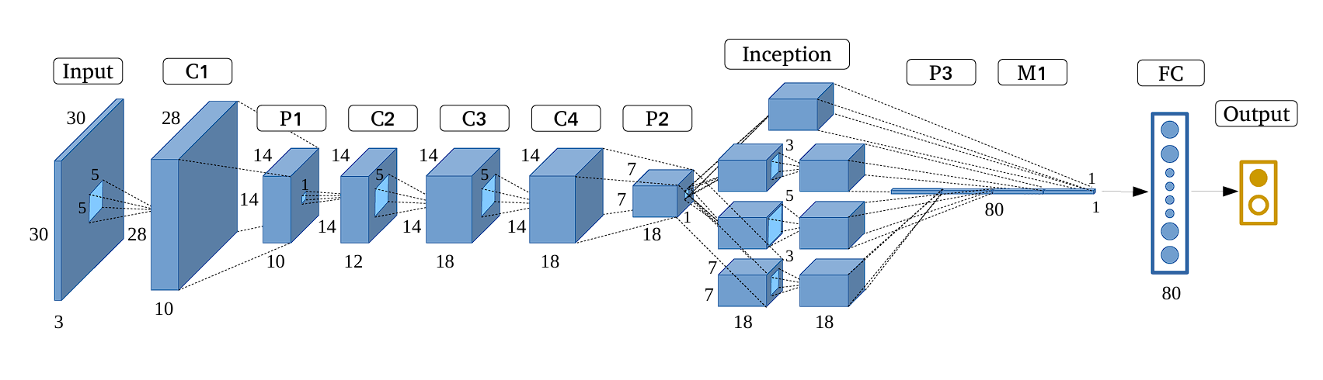
GoogleNet Architecture:

Slide 17
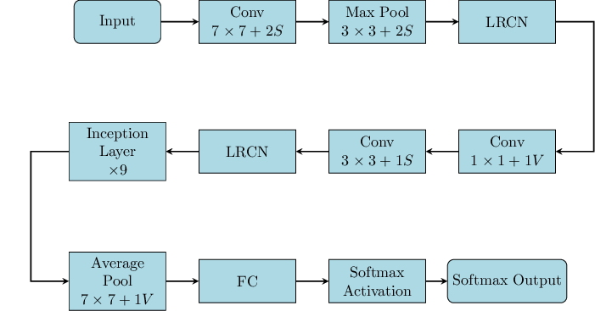
GoogleNet Workflow:

Slide 18
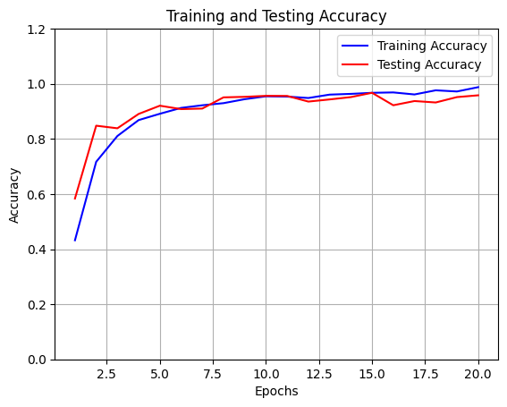
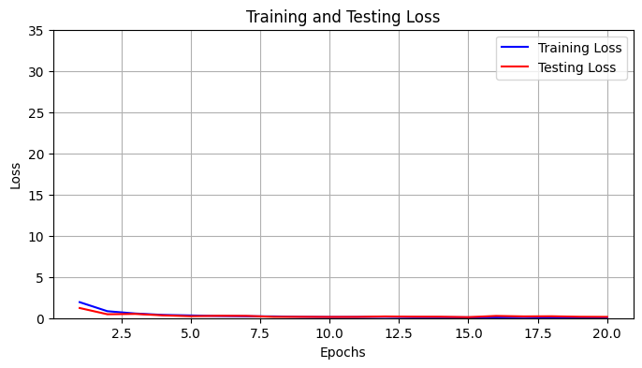
Accuracy and Loss plot of GoogleNet:

Slide 19
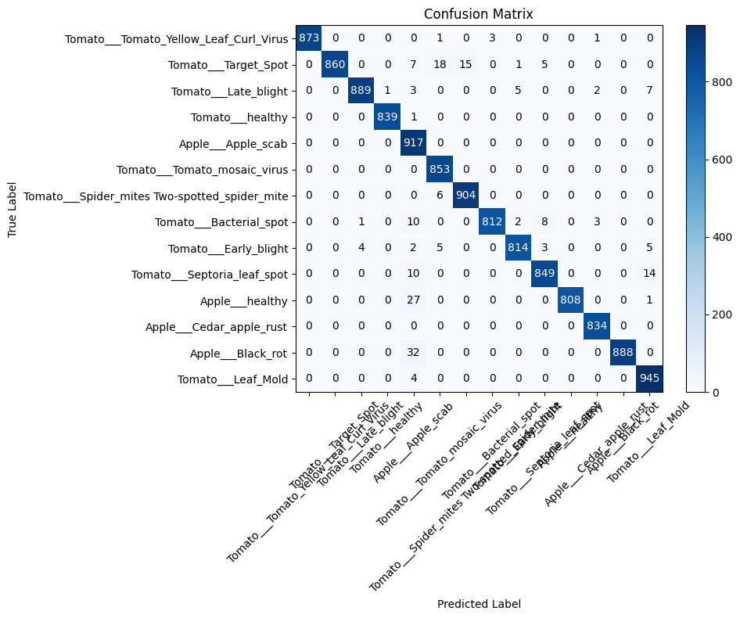
Confusion Matrix of GoogleNet:

Slide 20
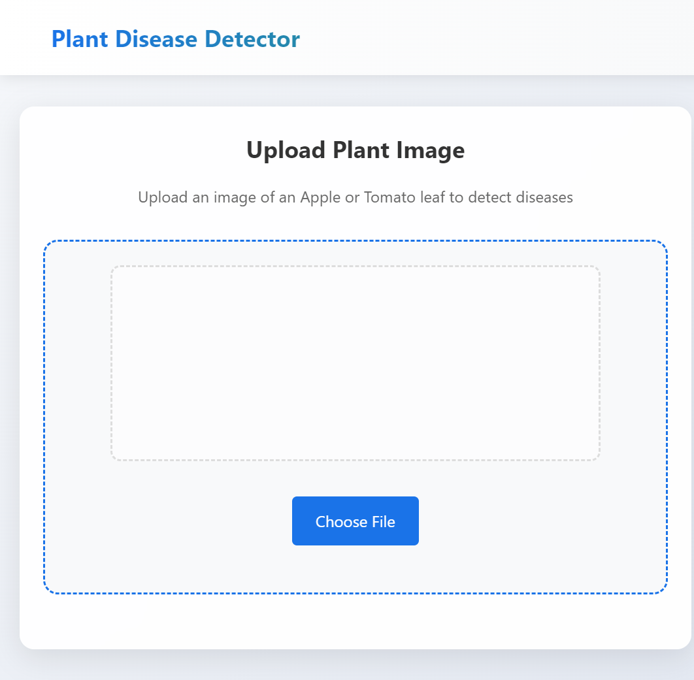
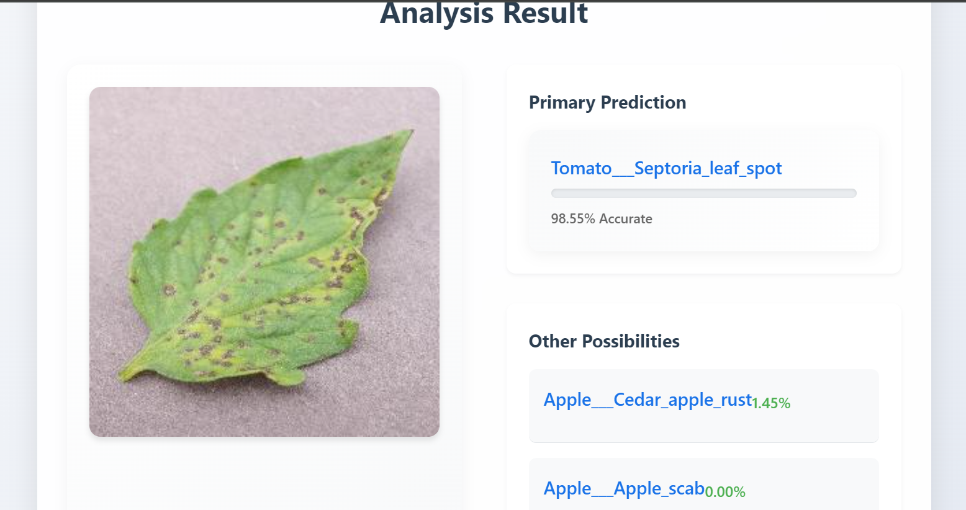
Website Images:

Slide 21
Approach to Achieving Objectives:
Model Selection and Evaluation: To identify the most effective architecture, we selected seven advanced deep learning models: GoogleNet, EfficientNet, ResNet, DenseNet, MobileNet, AlexNet, and Xception. Each model was trained and validated on a carefully curated dataset containing images of tomato and apple leaves categorized into 14 distinct disease classes.
Performance Metrics Comparison: The models were evaluated using key performance metrics, including accuracy, precision, recall, and F1 score, to ensure a comprehensive assessment. GoogleNet emerged as the best-performing model with a validation accuracy of 95.84%, precision of 96.02%, recall of 95.84%, and an F1 score of 95.85%.

Slide 22
Leveraging Transfer Learning: Pre-trained architectures, such as GoogleNet, were fine-tuned using transfer learning. Custom output layers were added to adapt the model for classifying the 14 disease categories. This approach significantly reduced training time while maintaining high accuracy.
Dataset Preprocessing and Augmentation: To ensure robustness, the dataset underwent preprocessing steps such as image resizing and normalization. Data augmentation techniques, including rotation, flipping, and scaling, were applied to increase the dataset's diversity and enhance the model's generalization capabilities.
Optimization and Training: Models were trained using the Adam optimization algorithm with an initial learning rate of 0.001 for 20 epochs, followed by fine-tuning for 10 additional epochs with a reduced learning rate of 0.0001. This two-phase training approach optimized the models' performance and ensured stable convergence.

Slide 23
Conclusion:
This project successfully demonstrates the application of deep learning to detect diseases in apple and tomato foliage. By leveraging the optimized GoogleNet architecture, the proposed framework achieves high accuracy (95.84%) while remaining lightweight and computationally efficient. These attributes make it a practical tool for real-time and mobile applications in agriculture. The study addresses key challenges in agricultural disease detection by providing a scalable, automated, and precise solution.
Future directions include expanding the dataset to encompass additional crops and diseases, enhancing the model’s robustness across diverse environmental conditions, and exploring edge-computing deployment for real-time field applications. The findings contribute to the broader goal of integrating AI and machine learning into sustainable agricultural practices.

Slide 24
REFERENCES:
Tm, P., Pranathi, A., SaiAshritha, K., Chittaragi, N. B., & Koolagudi, S. G. (2018, August). Tomato leaf disease detection using convolutional neural networks. In 2018 eleventh international conference on contemporary computing (IC3) (pp. 1-5). IEEE.
Dube, S. S., Chiwera, E., Nleya, S. M., Ndlovu, S., Zengeya, T., Marabada, N., ... & Mapenduka, W. (2023, November). Tomato Leaf Disease Detection System Using Convolutional Neural Networks. In 2023 2nd Zimbabwe Conference of Information and Communication Technologies (ZCICT) (pp. 1-4). IEEE.
Gargade, A., & Khandekar, S. A. (2019, March). A review: custard apple leaf parameter analysis and leaf disease detection using digital image processing. In 2019 3rd International Conference on Computing Methodologies and Communication (ICCMC) (pp. 267-271). IEEE.
B. U. Rani, K. Pavani, S. Bhavani and G. Alapati, "A Systematic Analysis of Deep Learning and Machine Learning Methods for Identifying Apple Leaf Disease," 2023 4th International Conference on Electronics and Sustainable Communication Systems (ICESC), Coimbatore, India, 2023, pp. 761-765, doi: 10.1109/ICESC57686.2023.10192948.
Ahil, M. N., Vanitha, V., & Rajathi, N. (2021, October). Apple and grape leaf disease classification using MLP and CNN. In 2021 International Conference on Advancements in Electrical, Electronics, Communication, Computing and Automation (ICAECA) (pp. 1-4). IEEE.

Slide 25
Sebastian, M., Suchithra, M. S., & Antony, C. M. (2023, December). Apple Leaf Disease Detection: Machine Learning & Deep Learning Techniques. In 2023 Intelligent Computing and Control for Engineering and Business Systems (ICCEBS) (pp. 1-5). IEEE.
Yang, J. (2024, September). Deep Learning for Tomato Leaf Disease Recognition in Balanced Data Environment. In 2024 4th International Conference on Computer Science and Blockchain (CCSB) (pp. 74-78). IEEE.
Brucal, S. G. E., de Jesus, L. C. M., Peruda, S. R., Samaniego, L. A., & Yong, E. D. (2023, October). Development of Tomato Leaf Disease Detection using YoloV8 Model via RoboFlow 2.0. In 2023 IEEE 12th Global Conference on Consumer Electronics (GCCE) (pp. 692-694). IEEE.
Kaur, A., Kukreja, V., Kumar, M., Choudhary, A., & Sharma, R. (2024, April). Multiclass Classification of Tomato Leaf Diseases using a Hybrid of LSTM and CNN Model. In 2024 IEEE 9th International Conference for Convergence in Technology (I2CT) (pp. 1-5). IEEE.
Chakraborty, S., Paul, S., & Rahat-uz-Zaman, M. (2021, January). Prediction of apple leaf diseases using multiclass support vector machine. In 2021 2Nd international conference on robotics, electrical and signal processing techniques (ICREST) (pp. 147-151). IEEE.

Slide 26
THANK YOU

